Slide 1
Microsoft Azure
Dot net tutorials Part 05

Slide 2
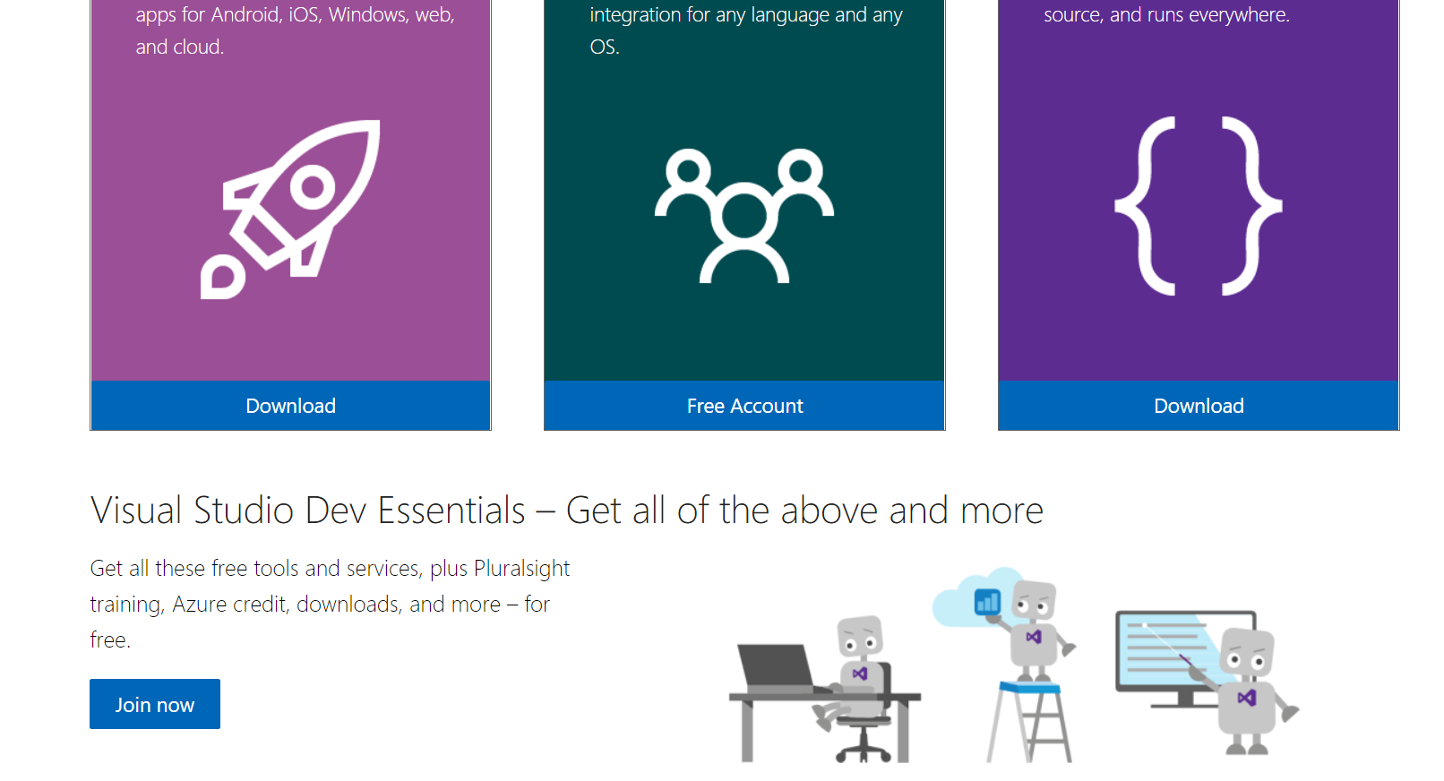
Acquiring an Azure Account
Go to:
https://visualstudio.microsoft.com/free-developer-offers/
Scroll down and click Join Now

Slide 3
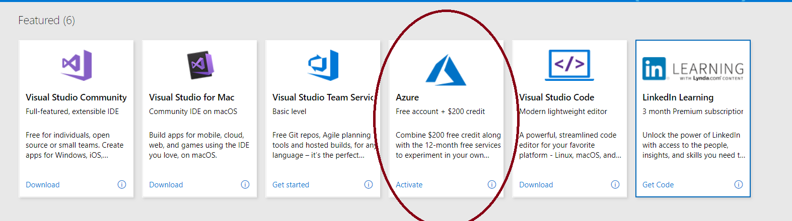
Acquiring an Azure Account
Click Activate by Azure
Log into your Microsoft account using your school email
Then you should be brought to your portal

Slide 4
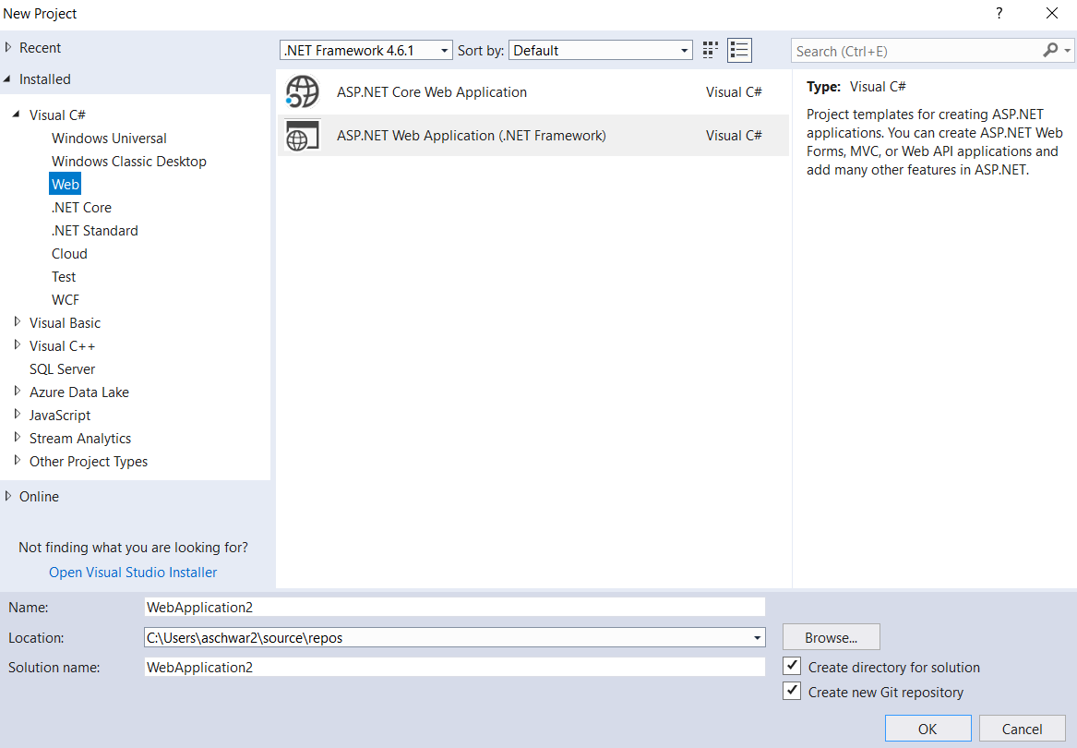
Using Azure
Make sure you have the Azure development tools in Visual Studio
Choose File → New → Project from Visual Studio
Click on Open Visual Studio Installer

Slide 5
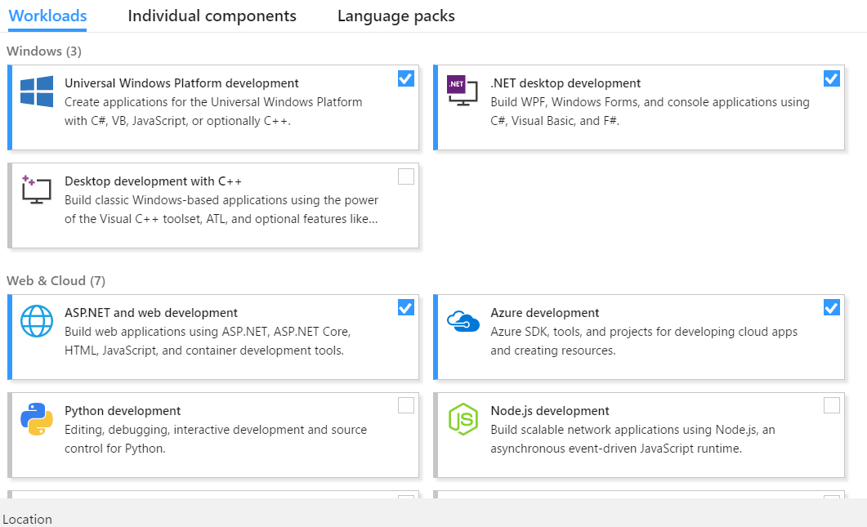
Using Azure
Make sure Azure development is selected

Slide 6
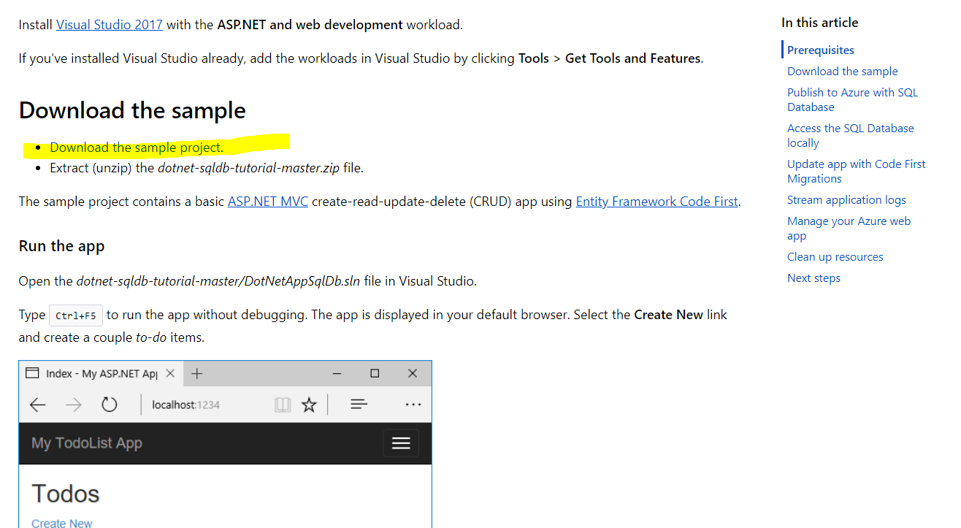
Microsoft Azure demo
The following demo is taken (and modified) from:
https://docs.microsoft.com/en-us/azure/app-service/app-service-web-tutorial-dotnet-sqldatabase
Download the Sample project from the URL above

Slide 7
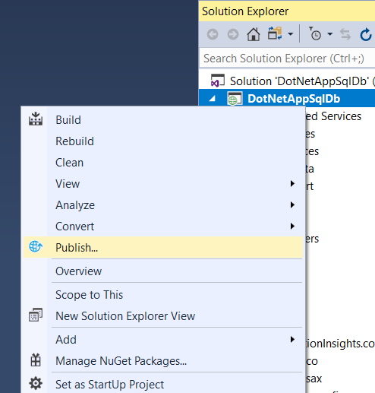
Microsoft Azure demo
Open the project in Visual Studio
double-click on the DotNetAppSqlDb.sln file
In Solution Explorer, right-click your DotNetAppSqlDB project and select Publish.

Slide 8
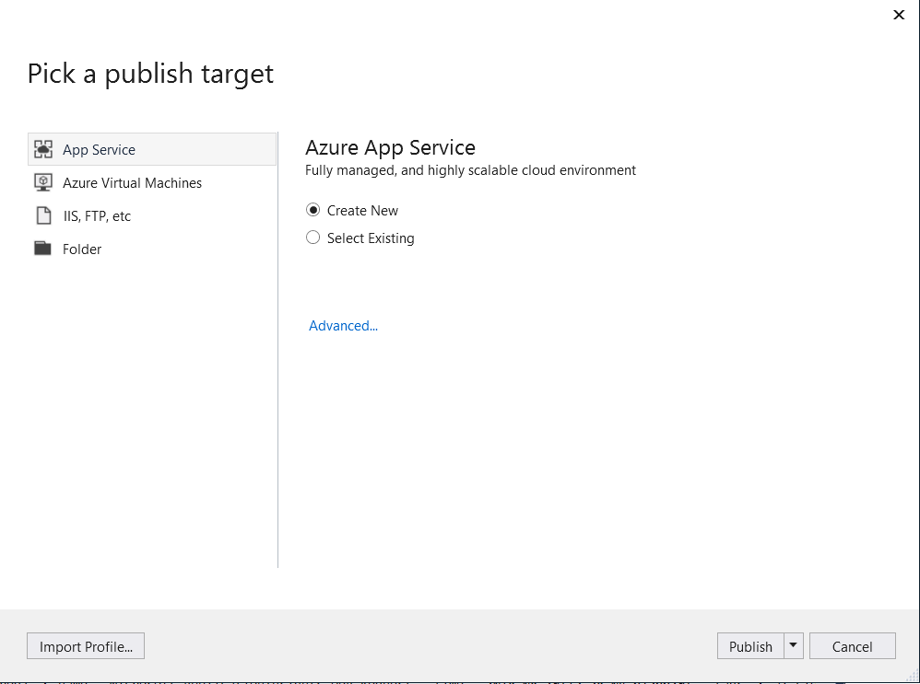
Microsoft Azure Demo
Choose App Service
Select Create New
Click Publish

Slide 9
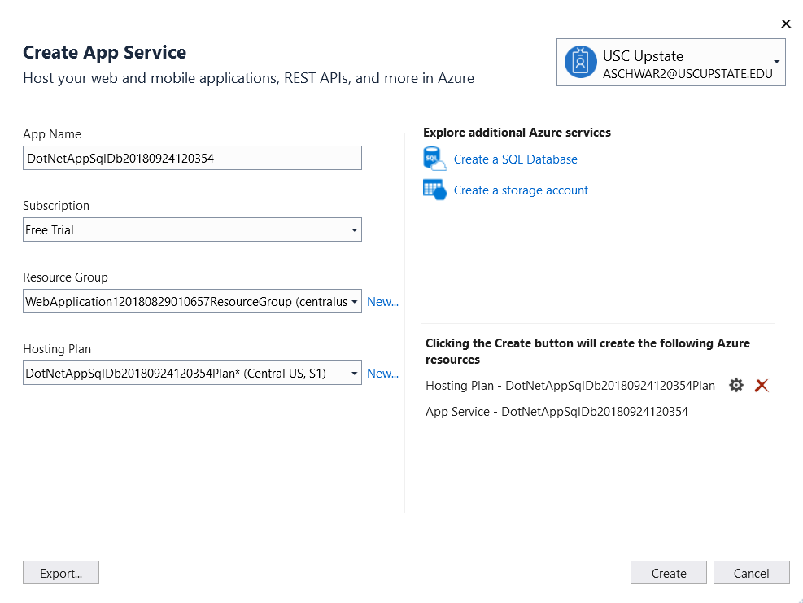
Microsoft Azure Demo
Click Create a SQL Database

Slide 10
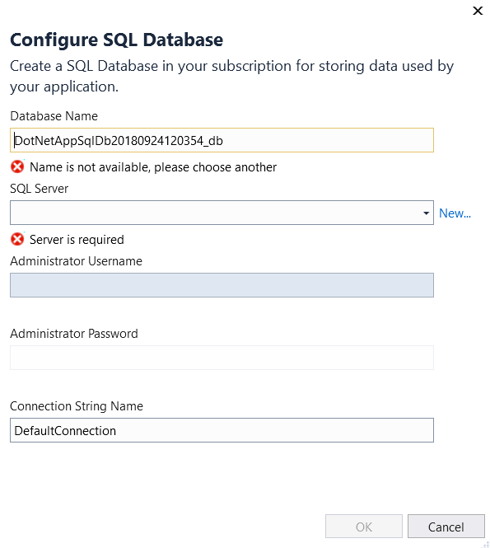
Microsoft Azure Demo
Click New next to SQL Server

Slide 11
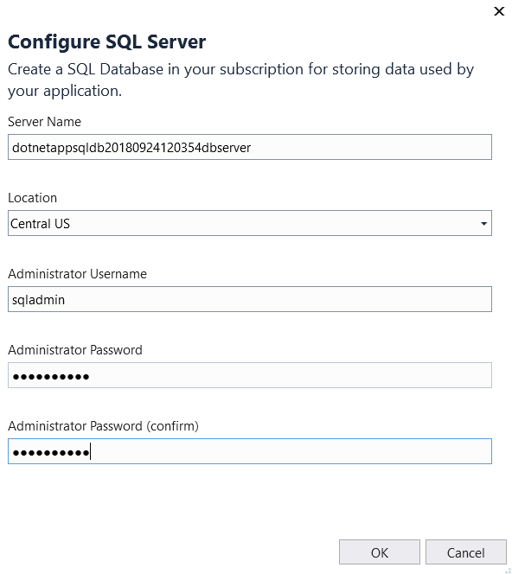
Microsoft Azure Demo
Choose a username and password. Make sure to remember it!
Click OK to exit the Configure SQL Server window.

Slide 12
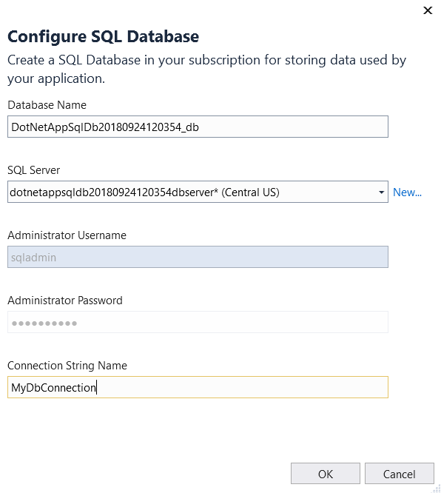
Microsoft Azure Demo
Make sure to enter a Connection String Name that matches your web.config file.
Click OK when done.

Slide 13
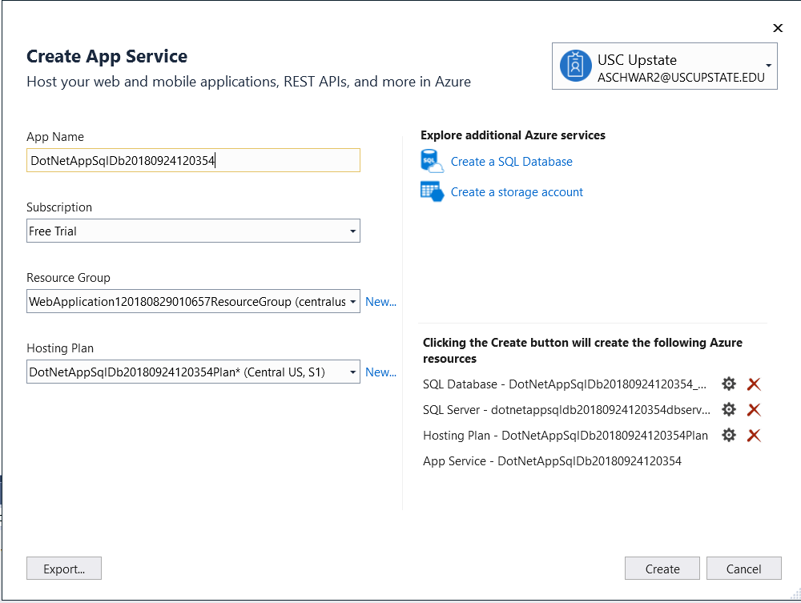
Microsoft Azure Demo
Next to Hosting Plan, click New

Slide 14
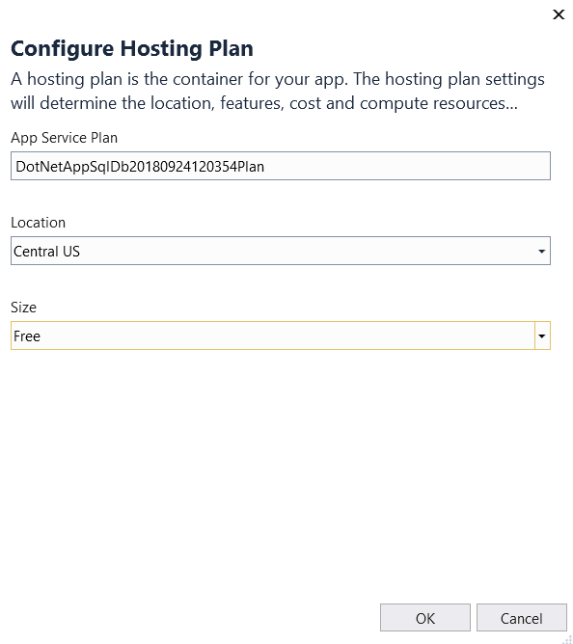
Microsoft Azure Demo
From the Size dropdown, make sure you choose Free.

Slide 15
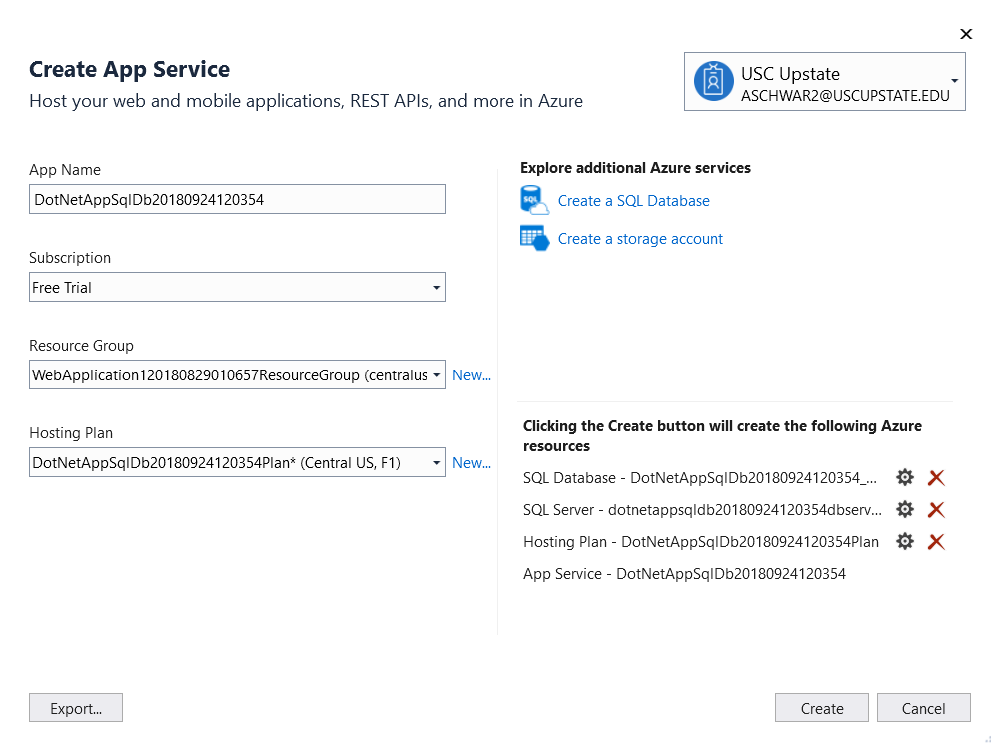
Microsoft Azure Demo
Click Create

Slide 16
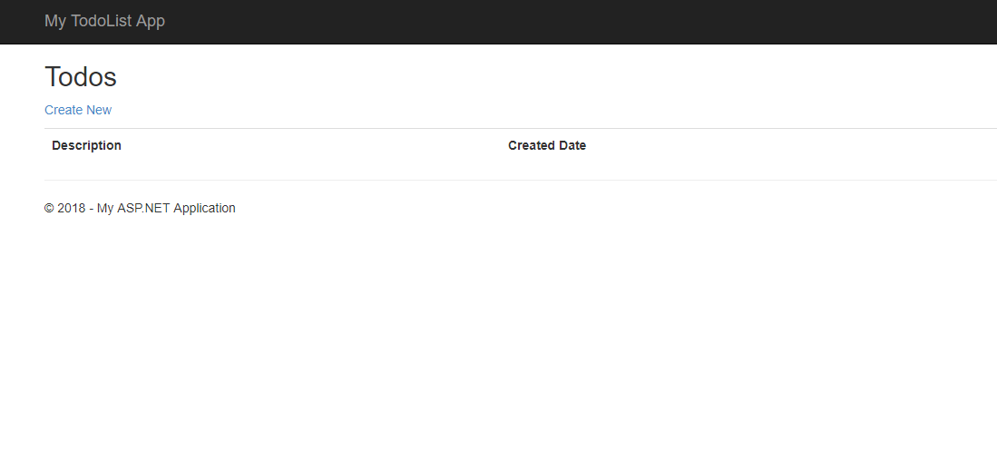
Microsoft Azure Demo
Once your app is finished publishing, your default browser is launched with the URL to the deployed app

Slide 17
Microsoft Azure Demo
Test your app by adding some content, editing, etc.
So where is this data going?
If we look at the Web.config in Visual Studio the Connection String says:
<add name="MyDbConnection" connectionString="Data Source=(localdb)\MSSQLLocalDB; Integrated Security=True; MultipleActiveResultSets=True; AttachDbFilename=|DataDirectory|MyDatabaseContext-12.mdf" providerName="System.Data.SqlClient"/>
So is it really going to (localdb)?

Slide 18
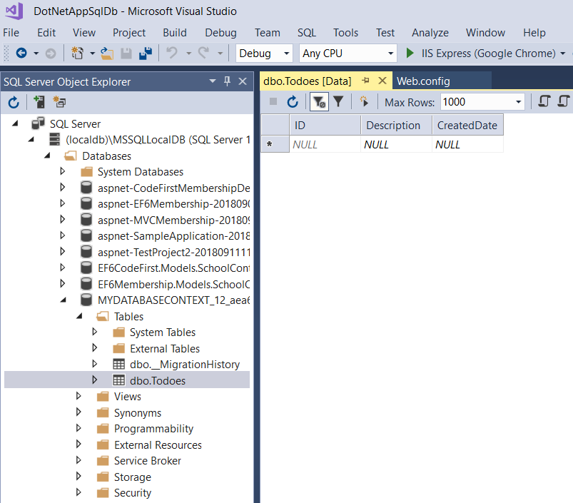
Microsoft Azure Demo
Obviously not, but you can verify by looking at the localdb instance in Visual Studio

Slide 19
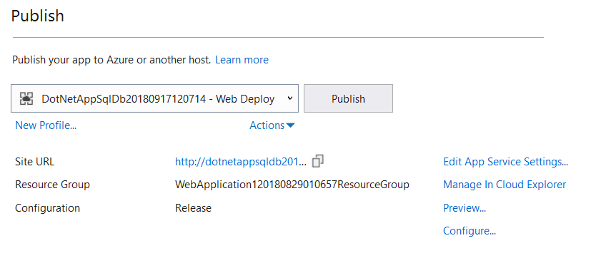
Microsoft Azure Demo
So how does it know where to go?
If you closed the publishing window, right-click on your project and choose Publish.
Then click Configure

Slide 20
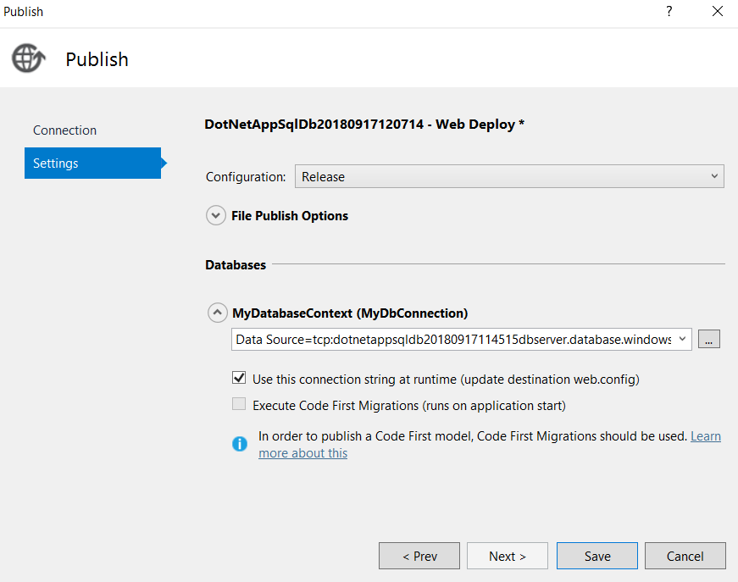
Microsoft Azure Demo
Click on the Settings tab
Notice the box that is checked

Slide 21
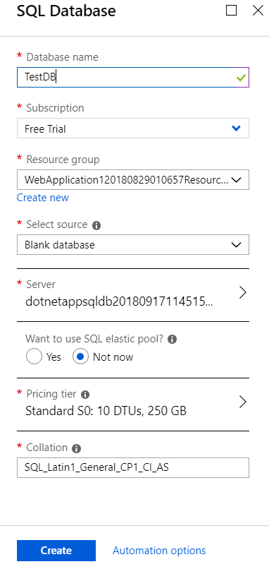
Microsoft Azure Demo – DB-First
Navigate to portal.azure.com from a browser window
(Note: Login if necessary)
Click on SQL databases, then Click Add.
Fill in the information
Click Create
Note: you will be redirected to the SQL databases home page, but your database may not be there yet. It can take several minutes for your db to get created.

Slide 22
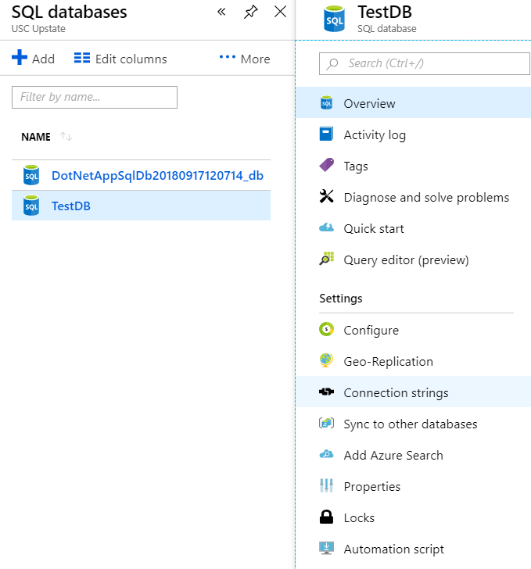
Microsoft Azure Demo – DB First
Once the db does show up, click on it and find the Connection strings tab
If you click on the Connection strings, it will display what you would need to put in your web.config to connect to it.
Note: you can also use this to connect to it through SSMS

